Slide 1
Timeline for the Draft new Naas LAP 2018-2024
Sept/Oct 2017: Naas Local Area Plan Public Consultation Issues Paper – 19 Sept to 24 Oct
3 Oct 2017: Naas Local Area Plan consultation open day
Jan-Feb 2018: Chief Executive’s Report on Issue Paper & Submissions circulated to members.
22 Jan 2018: Naas Planning Advisory Group – Plenary Workshop
March/April 2018: Publish Draft new Naas LAP
Pre-draft Naas Local Area Plan 2018-2024

Slide 2
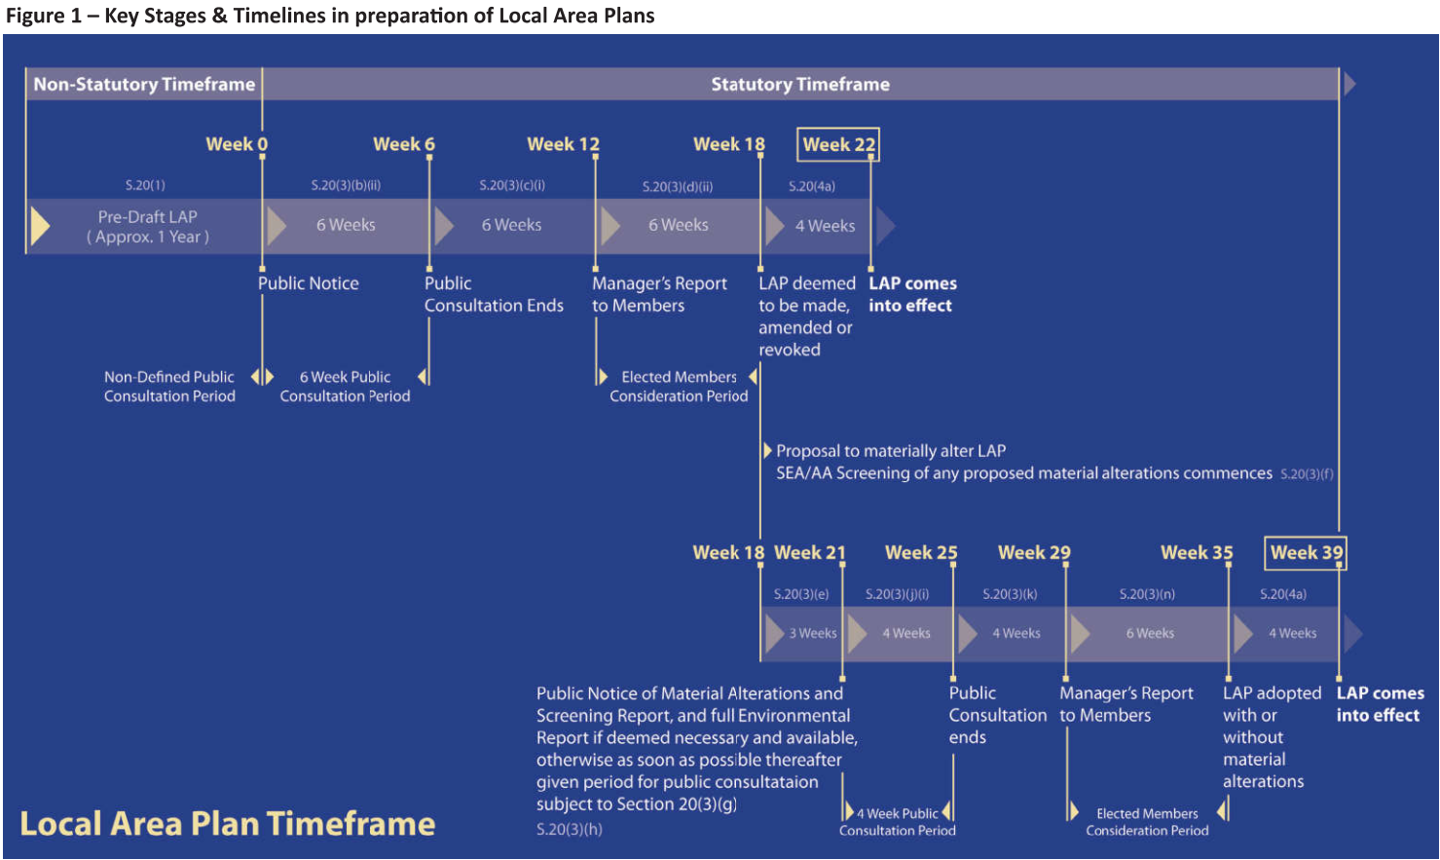
Timeline for the new Naas LAP
Local Area Plans – Guidelines for Planning Authorities DECLG June 2013

